Slide 1

Brittany Hoffman July 1, 2020 Computer Programming Internship Project Presentation

Slide 2
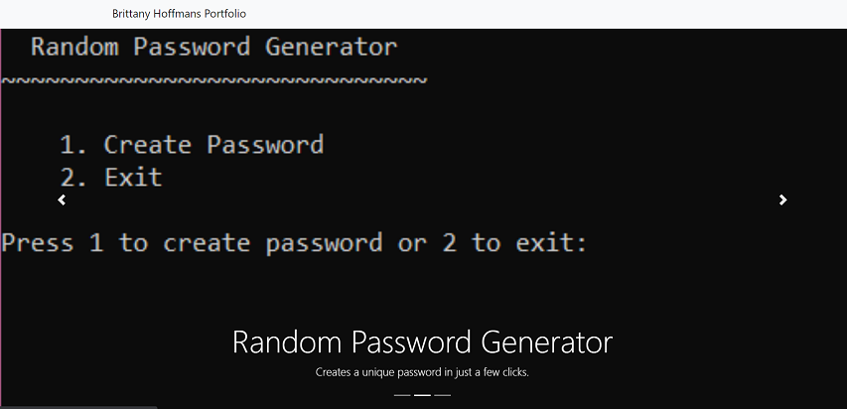
Web Interface
For my web interface I decided to keep it simple and clean.
When first entering the site there is a slideshow of my projects.
Each picture in the slideshow gives its name and a brief description of the project.

Slide 3
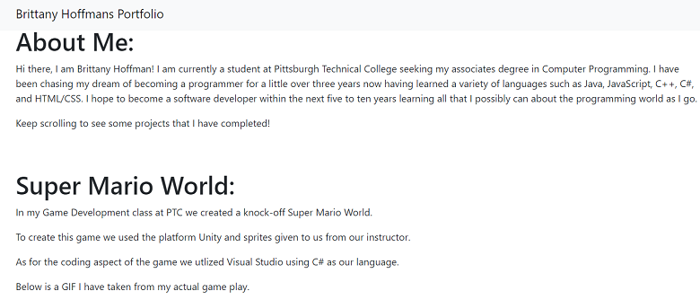
Web Interface
Scrolling down you can find a quick introduction of myself along with a sample project that was completed for a previous programming class.
Staying with the simple theme for my portfolio I decided for each project to give a quick explanation of what the project entails along with how I went about creating them.

Slide 4
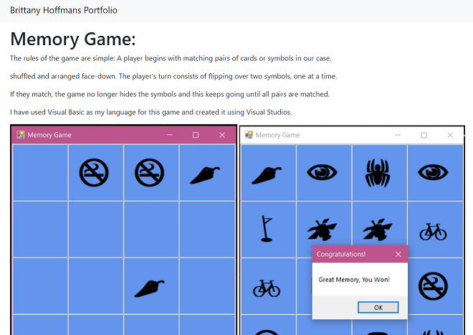
Web Interface
After each projects description I included either a GIF or picture of the project in action.
For the pictures I captured the projects either in action or completed.
And for the GIFs I felt it best to capture the most important parts of the game play.

Slide 5
Memory Game
For the first project I created a childhood classic, the game of memory!
Most everyone has played this game, simply place the cards face down or in our case a blank square and flip (click) on two cards to try and find their match.
Once the player has found a match those two symbols stay face up.
This process is repeated until all matches are found within the timers limit.
If the player did not match all the symbols within the time frame they lose.

Slide 6
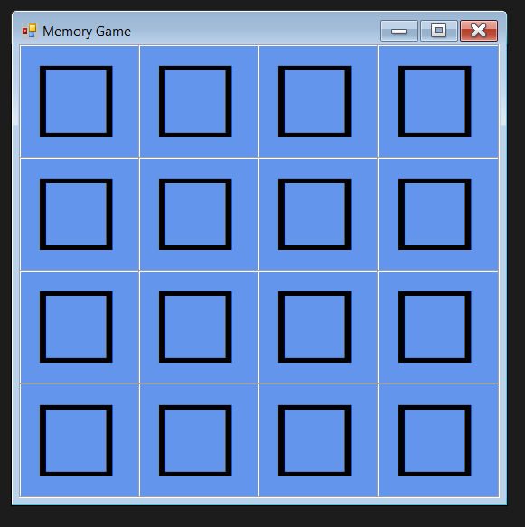
Memory Game
In order to create this game I used the Visual Studios Windows Forms App (.NET Framework) template and Visual Basic as my language.
I started by creating a table, adjusted the size and properties of the table to create the basic outline for the game.

Slide 7
Memory Game
I added a random object and a list of icons to be matched.
For the icons I used the Webdings font.
In order to match each icon to the labels I used a For Each loop to access each labels properties and methods.
In order to keep the matching symbols face up I added a click event handler to each label.

Slide 8
Memory Game
The timer waits a 750 milliseconds for the player to click on two squares.
If they match the symbols stay otherwise they go back to being blank.
In order to keep the matching symbols shown I added an if statement to the label click method.
And finally to check if the player has won or not I added a check for winner method that goes through each symbol checking for matches.
When you win the game displays a congratulations message box!

Slide 9
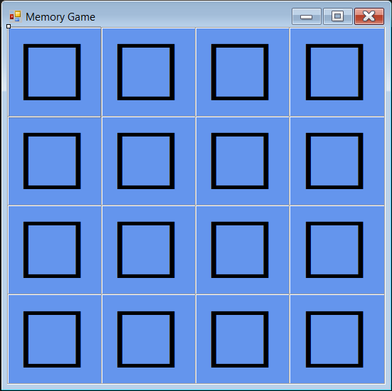
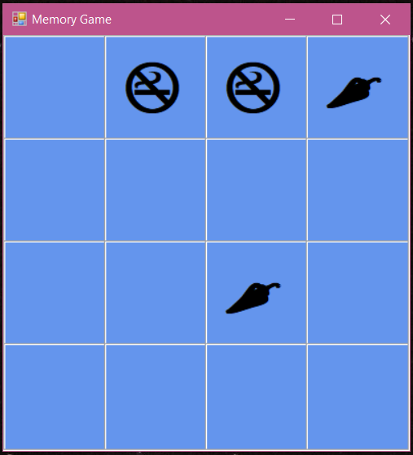
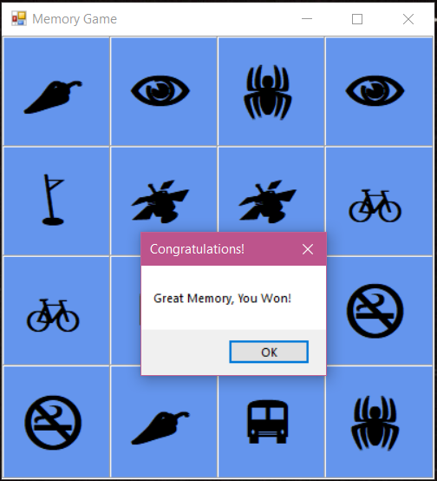
Memory Game
The game start to finish looks as such:

Slide 10
Password Generator
For my second project I created a random password generator.
In order to create this I used Visual Studios once again but used C++ as my programming language this time.

Slide 11
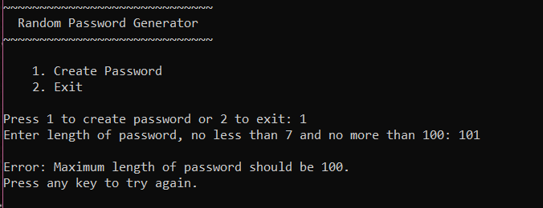
Password Generator
To create the password the user needed to implement upper case, lower case, numbers and special symbols.
The password can be no less than 7 characters and no more than 100.

Slide 12
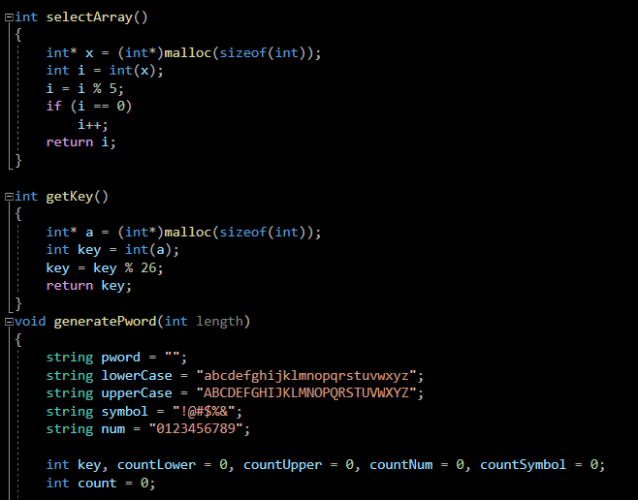
Password Generator
To begin I used a select array to randomly generate an integer between 1 and 4 to decide if it will choose a lowercase, uppercase, number or symbol.
Then I created the get key function to generate an integer between 0 and 25 to decide which letter of the alphabet to use.
Next I had to generate the password itself with all of its restrictions and special characters and count each of them separately.

Slide 13
Password Generator
Each of the cases checked to see if the required letters, numbers and symbols had been fulfilled, if not then the program will break.
As for the menu itself I kept it simple and easy to navigate for the user.
All the requirements are listed at the top of said menu and the output is easily accessed if the user complies with the restrictions stated above.

Slide 14
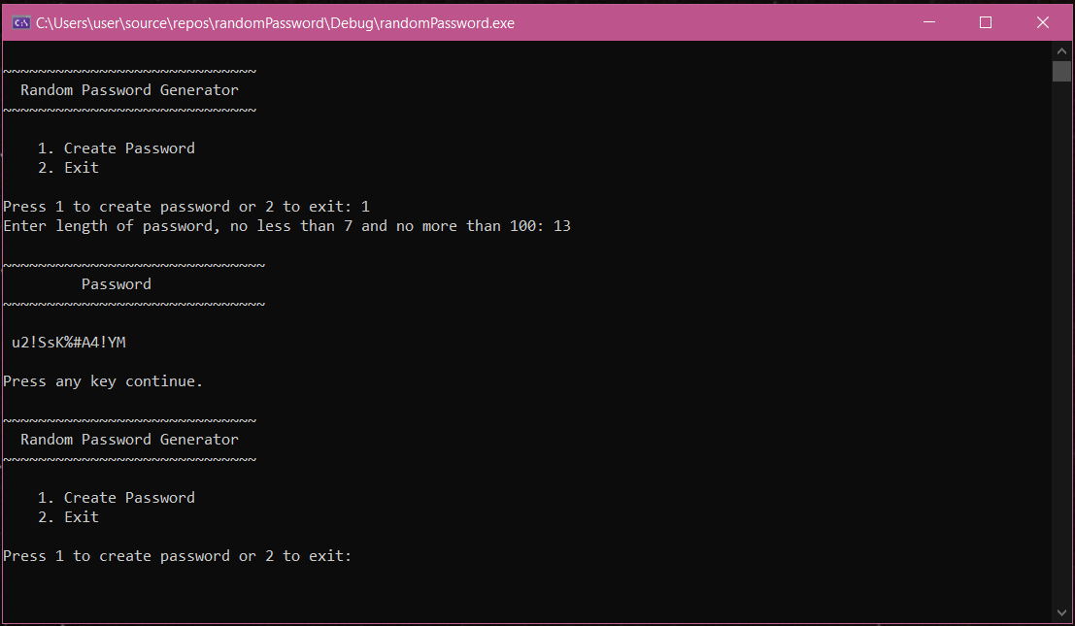
Password Generator
Start to finish this is how the program works:

Slide 15
Tetris
For my final project I once again went with a childhood classic, Tetris!
Tetris also has very simple rules: You can only move the pieces in specific ways, your game is over if your pieces reach the top of the screen. You can only remove pieces from the screen by filling all the blank space in a line.
To create this game I used Unity with C# as it's language using Visual Studio.

Slide 16
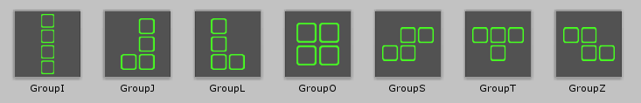
Tetris
To begin I went with the 2D template provided by Unity.
Once I got my basic outline such as the size and background of the game completed I went on to create the shapes.
Each of the 7 shapes are made into the letters: I,J,L,O,S,T,Z.

Slide 17
Tetris
After all the basic parts of the game were completed it was time to create the game play objects using C#.
I started with the Spawner function that spawns a random group (individual letters) when needed.
Next was Playfield, it stores the grid itself and a few useful functions to work with it.

Slide 18
Tetris
After creating functions to get the groups moving it was time to add some actual game play.
These functions told the groups which direction to move, whether or not to delete the completed row or keep stacking on top of the rows and how to rotate to make the pieces fit one another.
Lastly it was time to add each individual script to the groups themselves in order for the game to come full circle and work properly.

Slide 19
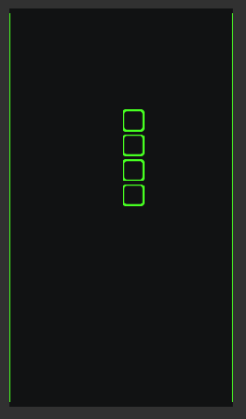
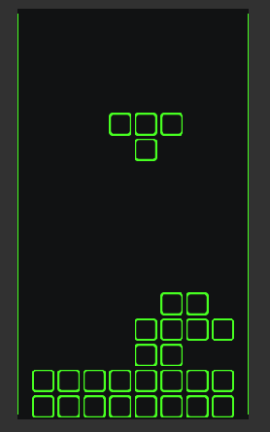
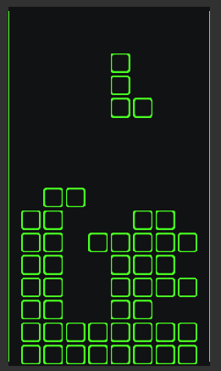
Tetris
Here is the game in all its glory:

Slide 20
Memory Game Reflection
This was my favorite project to create. I enjoyed the creative aspect of making it and was reminded of how much I enjoy coding in Visual Basic.
My weakness when it came to this project was how tedious creating the basic outline was which also turned out to be my strength as well because once completed the overall feeling of accomplishment reminded me why I got into programming.

Slide 21
Password Generator Reflection
This project took me back to the basics of coding where there is no need to be creative only the need of functionality.
My strength for this one is that I find C++ to be one of the languages that I am fully confident in writing it.
My weakness was that there really was no need to be creative therefore I found myself being easily distracted while coding it.

Slide 22
Tetris Reflection
This final project was a fun one to make for me.
You can ask any one of my classmates I have made it very well known that I am not a fan of using Unity for a project which is why I felt I needed to include it within my portfolio to prove to myself that I can in fact do it and do it well.
I found that my strength was my willpower to sit down and really give this my all since I have told myself for months now that I am not the best at it. So for me to actually complete this project and have it work the way it was intended to was a full circle moment for me.

Slide 23
Overall Reflection
Overall I enjoyed this final class immensely. The free rein to do whatever we wanted was exactly what I personally needed to finish out my college career. It reminded me of languages I had forgotten and languages I love. My time at PTC was one of the best experiences thus far in my life. From the teachers who never gave up on us to the friends I have made along the way I could not be more proud to be an alumni!

